Slide 1



ML PROJECT PRESENTATION
FAKE NEWS DETECTION USING
ML TECHNIQUES
GROUP NO. 9
1

Slide 2


MOTIVATION
Fake News is a challenging problem in today's times.
Social Media websites are flooded with much misinformation, which can prove fatal.
Twitter particularly struggles with the fake news problem.
However, there is a certain regular pattern in fake news. Some individuals are more likely to spread fake news.
We can use Machine Learning to identify such patterns and try to predict fake news.
2

Slide 3

LITERATURE REVIEW
Researchers used ML models like logistic regression and deep learning models.
Researchers describe the use of detecting fake news.
They discuss vectorization techniques like TF-IDF and BOW to convert text to numeric values.
Researchers discussed the importance of addressing the bias using lexical and sentiment analysis.
They experimented with several models like SVM, Random Forest etc.
3

Slide 4
DATASET USED
Used Liar Dataset
It contains sentences with their speakers and their affiliations with labels representing fake news or not.
The dataset contains 16 columns and 12788 rows.
Some columns are labels, statement speakers, etc.
4

Slide 5
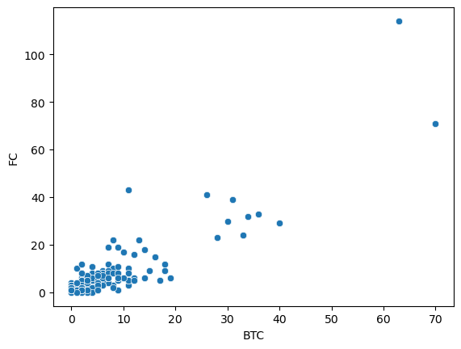
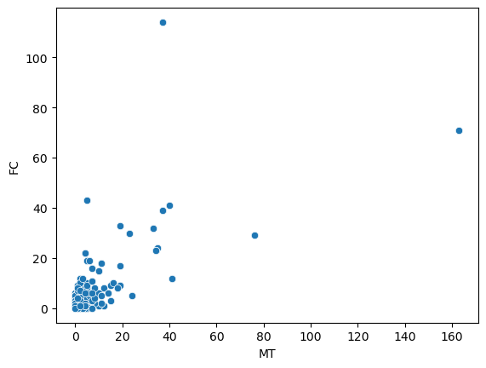
EDA SOME SCATTERPLOTS !!!
5

Slide 6
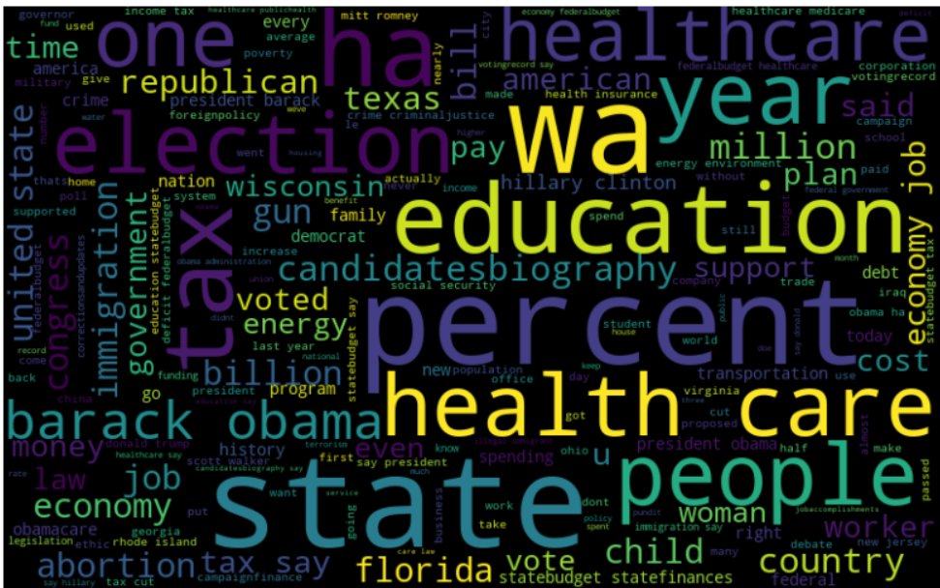
DATA PREPROCESSING
We clean the data and remove punctuation marks, white spaces, etc
We tokenize the data using NLP
We use TF-IDF and BOW to vectorize the tokenized data into numeric form.
We use wordcloud to visualize the word frequencies.
We use a label encoder on Political Party and speaker column.
6

Slide 7
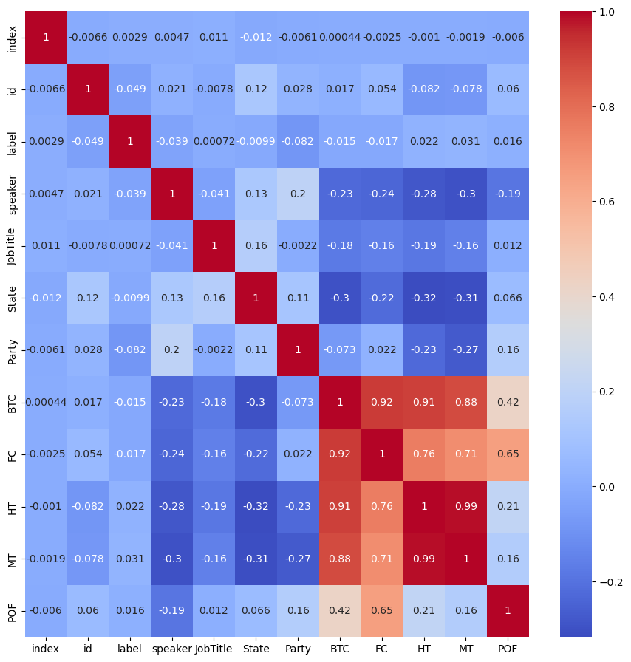

DATA PREPROCESSING - 2
We dropped 12 columns out of 16 columns
The decision to keep which columns were
taken based on the heatmap.
Columns with high correlation were dropped.
We take 4 partitions of data with and without party and speaker using TF-IDF and BOW.
7

Slide 8




MORE ON NLP !!!
We use TF-IDF and BOW in NLP vectorisation.
8

Slide 9
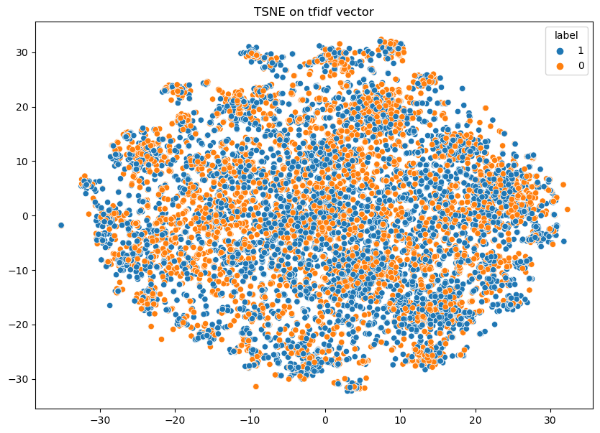
PERFORMING TSNE !!
Following is the result of TSNE on TF-IDF Vector
9

Slide 10

ML MODELS
1
We use Grid Search to find the best hyperparameters
We report the accuracies and loss curves for various ML models like SVM, Neural networks etc.
2
The results are for TF-IDF in NLP without considering the party and speaker name.
3
10

Slide 11
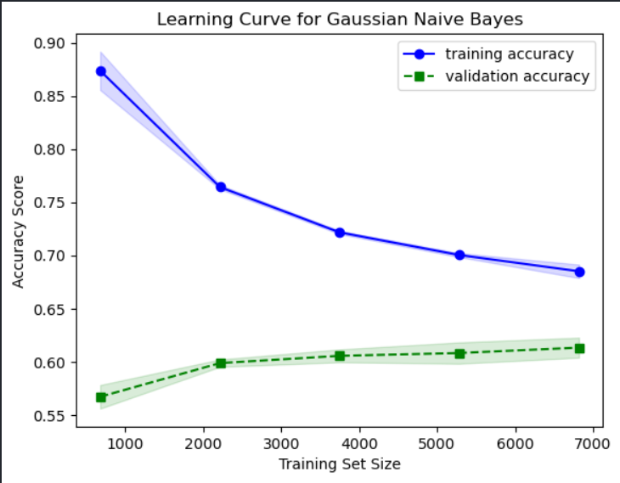

GAUSSIAN NAIVE BAYES
The accuracy using Gaussian Naive Bayes is 58.09%
11

Slide 12
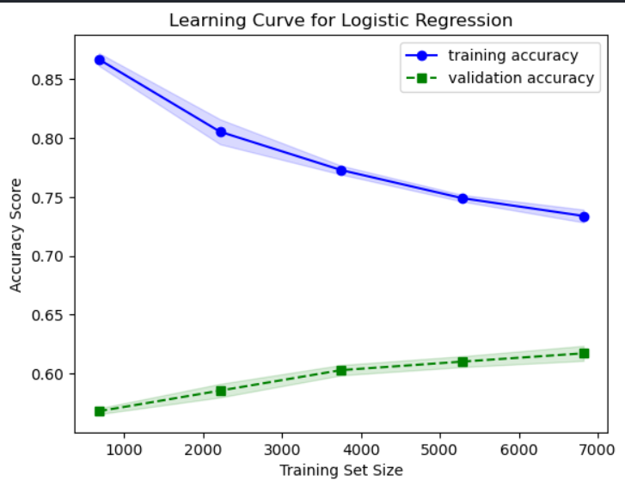

LOGISTIC REGRESSION
The accuracy using Logistic Regression is 61.74%
12

Slide 13
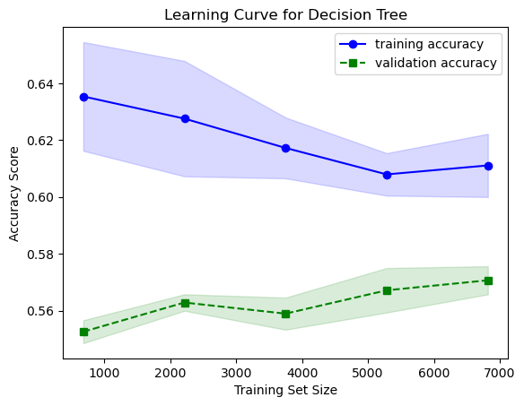
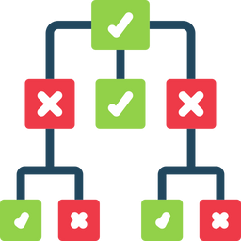
DECISION TREE
The accuracy using the Decision Tree is 56.91%
13

Slide 14
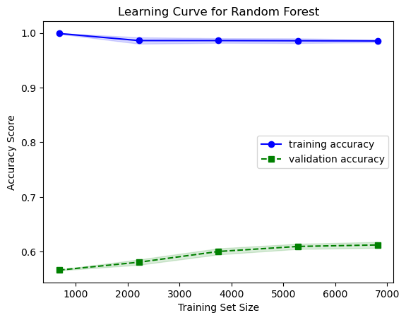

RANDOM FOREST
The accuracy using Random Forest is 59.57%
14

Slide 15
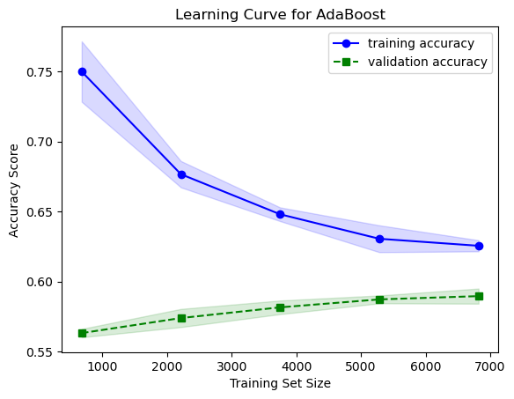

ADABOOST
The accuracy using Adaboost is 58.93%
15

Slide 16
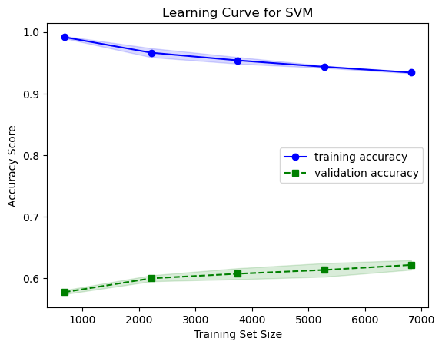

SVM
The accuracy using SVM is 59.34%
16

Slide 17
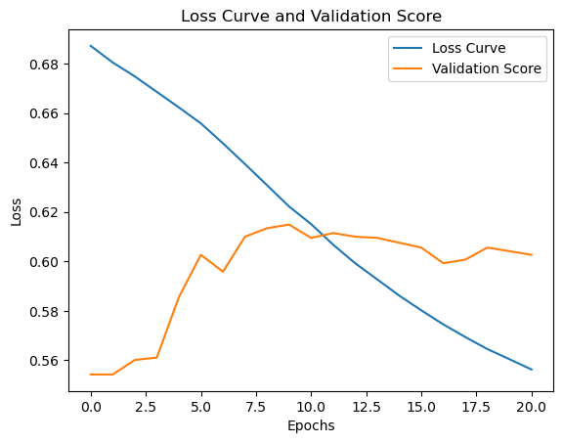
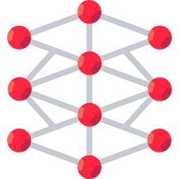
MLP
The accuracy using MLP is 58.95%
17

Slide 18
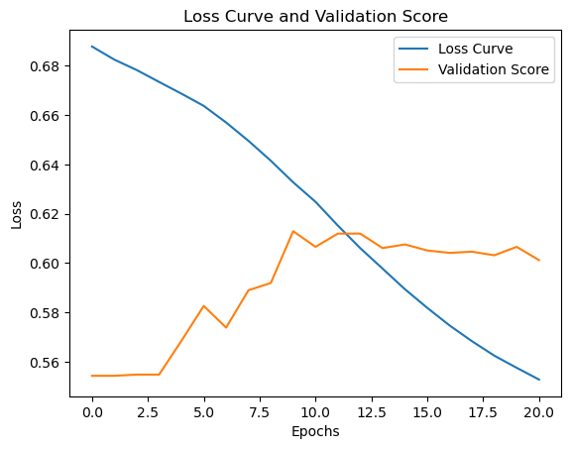

MLP WITH PCA
The accuracy using MLP along with PCA is 57.70%
18

Slide 19
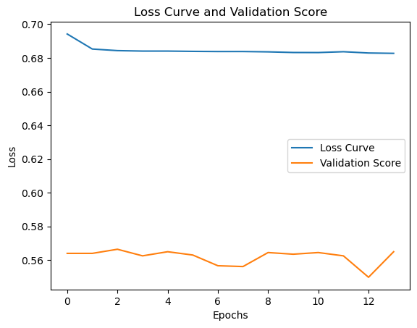
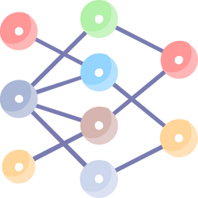
MLP WITH TSNE
The accuracy using MLP along with TSNE is 55.27%
19

Slide 20
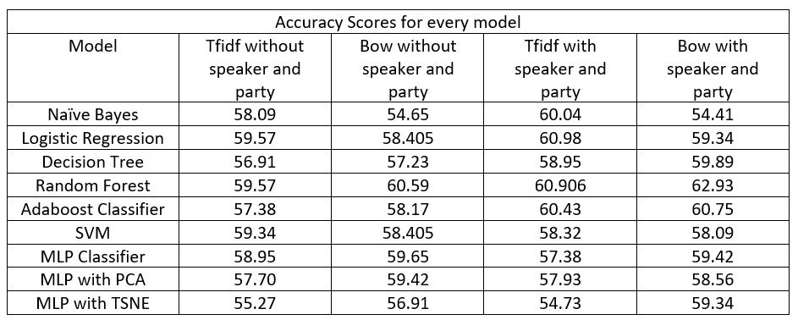
RESULTS SUMMED UP !!
20

Slide 21

LIMITATIONS
The accuracies are close to 60%, which is not much efficient.
This is because it's impossible to solve this problem using standard ML and NLP Techniques.
It is impossible to predict whether the news is fake without knowing the ground truth at that time.
21

Slide 22

CONCLUSION
We can predict whether the given news is fake or not with an accuracy better than a random guess i.e. 50%.
The best accuracy was 62.93% using Random Forest, BOW vectorisation, with speaker and party and Gini gain as feature selection criteria.
22

Slide 23

FUTURE WORK
We can extend the scope by also incorporating visual and audio content in news articles.
We will try to incorporate languages other than English.
Develop an interactive system where users can give a news article as input and can receive a credibility score for that article, suggesting its credibility.
23

Slide 24


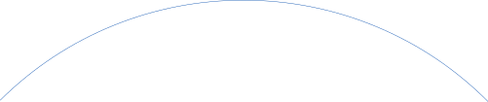

Timeline
Week 9
Week 8
Week 10
Learned about TSNE and PCA.
Observed accuracy of the MLP with and without TSNE
Learned about MLP.
Implemented MLP in code.
Observed the accuracy of the model.
Documented the complete project.
Did a complete analysis of performance of all models
Week 7
Week 11
Learned about SVM
Implemented SVM Model in the Code
Identified the future work
Identified the limitations
24

Slide 25

Work Division
Sahil Goyal
Deeptorshi Mondal
Handled the data preprocessing part
Helped in implementing the ML Models
Vibhor Agarwal
Anshak Goel
Handled the documentation
Also helped in NLP Part.
Handled the NLP Part.
Also did some data preprocessing
Decided which ML Models to use.
Analyzed the accuracies of the models.
25

Slide 26

ANY QUESTIONS ?
26

Slide 27

REFERENCES
https://arxiv.org/pdf/1705.00648.pdf%E2%80%8B
https://www.researchgate.net/publication/336436870_Fake_News_Detection_Using_Machine_Learning_approaches_A_systematic_Review
https://paperswithcode.com/paper/liar-liar-pants-on-fire-a-new-benchmark
https://github.com/manideep2510/siamese-BERT-fake-news-detection-LIAR
27

